Slide 1
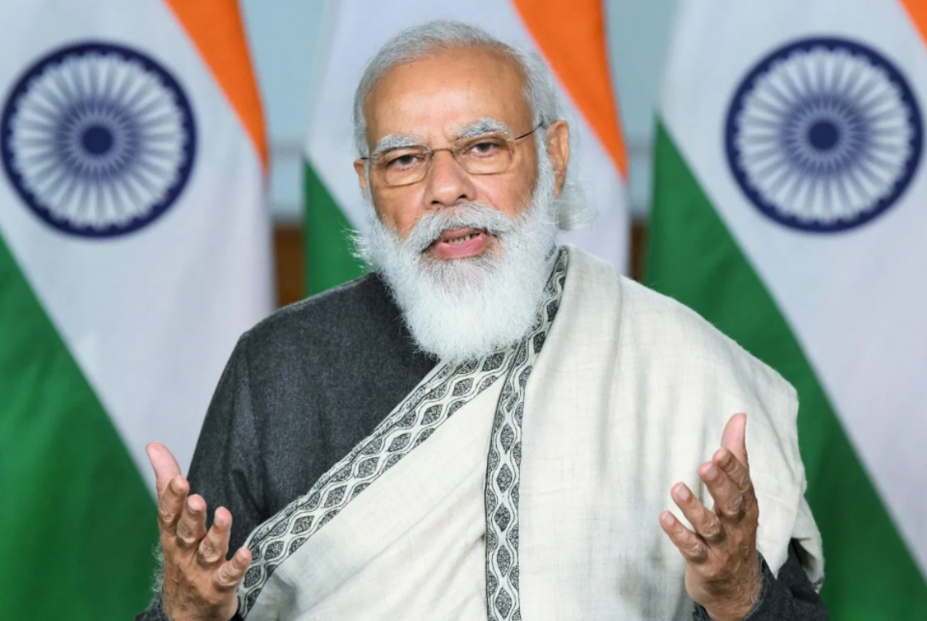
THE BUDGET 2021-22
A BUDGET FOR HEALTHY, ATMANIRBHAR AND DIGITAL BHARAT
R KRISHNAN Mcom FCA (DISA)

Slide 2
THE SIX PILLARS
Health and Well being
Physical & Financial Capital, and Infrastructure
Inclusive Development for Aspirational India
Reinvigorating Human Capital
Innovation and R&D
Minimum Government and Maximum Governance

Slide 3
THE FIRST PILLAR - Health and Wellbeing
Allocation – Rs 2,23,846 Crs – Increase of 137% from 20-21 budget

Slide 4
THE FIRST PILLAR - HIGHLIGHTS
Vaccines/Nutrition/ Water supply
Rs 35,000 Crs for Covid 19 Vaccine.
Made-in-India Pneumococcal Vaccine to be rolled out.
Mission Poshan 2.0 to be launched.
Rs 2,87,000 Crs for Jal Jeevan mission.
2.86 Crs Household tap connections.
Health Systems
Rs 64,180 Crs over 6 years for PM Aatma Nirbhar Swasth Bharat Yojna.
4 Regional National institutes for virology.
Integrated public health labs in all districts in 11 states.
Critical care hospital blocks in 602 districts.
17 new public health units.
Swachh Bharath Swasth Bharat/Clean Air
Rs 1,41,678 Crs over 5 years for Urban Swachh Bharat Mission 2.0
Reduction in single use plastic.
Bio-remediation of all legacy dump sites.
Complete faecal sludge management and waste water treatment.
Rs 2,217 Crs to tackle air pollution, for 42 urban centers.
Scrapping Policy
Voluntary vehicle scrapping policy to phase out old and unfit vehicles.
Fitness tests in automated fitness centers
– After 20 years –in case of personal vehicles.
After 15 years in case of commercial vehicles

Slide 5
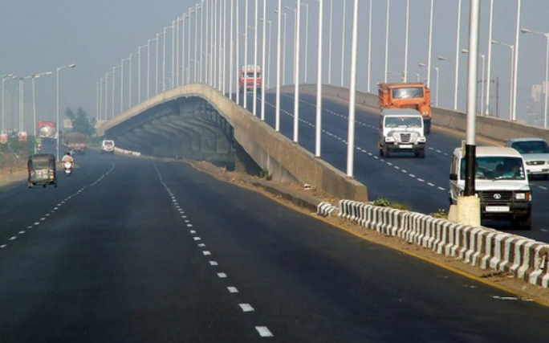
THE SECOND PILLAR – Physical and Financial Capital and Infrastructure

Slide 6
THE SECOND PILLAR - HIGHLIGHTS
Rs 1.95 lakh Crs in next 5 years for PLI Schemes in 13 sectors.
Mega Investment Textile parks. 7 Textile parks to be established over 3 years
Rs 20,000 Crs to set up and capitalise Development Financial Institution to act as a provider for financing.
Sharp increase in Capital Budget – Rs 5.54 lakh Crs (Increase of 34.5 percent over last year)
Recapitalisation of PSBs –
Rs 20,000 Crs in 21-22 to further consolidate the financial capacity of PSBs
Expansion of Metro Rail Network
Kochi Metro railway Phase 2 of 11.5 kms at a cost of 1957.05 Crs
National Hydrogen Energy Mission 21-22 to be launched
Minimum loan size eligible for debt recovery under the SARFAESI Act 2002 reduced from 50 lakhs to 20 lakhs.
Increasing FDI in INSURANCE SECTOR – 49% to 74%
ASSET MONETISATION
Roads/Railway Infrastructure
Rs 1.18 lakh Crs outlay for ministry of road transport.
8500 Kms road to be constructed by March 22.
Rs 1.10 lakh Crs outlay for railways.
Broad Gauge route kms electrification to reach 46,000 by 2021.

Slide 7
THE SECOND PILLAR – HIGHLIGHTS – Contd..
COMPANY MATTERS
Decriminalising the LLP Act 2008.
Revised threshold for small companies – <50 lacs Cap to <2 Crs and <2 Crs T/o to < 20 Crs.
Incentivizing the incorporation of One Person Companies to promote start ups –
. Allowing conversion into other type without restrictions.
. Residency limit reduced to 120 days for Indian citizen to set up OPC’s
. Allowing NRI’s to incorporate OPC’s
Launch of MCA21 Version 3.0 in 21-22 with AI and Machine learning.
Faster resolution of cases by strengthening NCLT framework.
DISINVESTMENT AND STRATEGIC SALE
IPO of LIC in 2020-21
Rs 1,75,000 Crs estimated receipts from disinvestment.
Strategic devolepment of BPCL, Air India, IDBI, BEML, Pawan Hans etc to be completed by 21-22
2 PSB’s and 1 GIC to be privatised.
Special purpose vehicle in the form of company to monetize idle land.

Slide 8
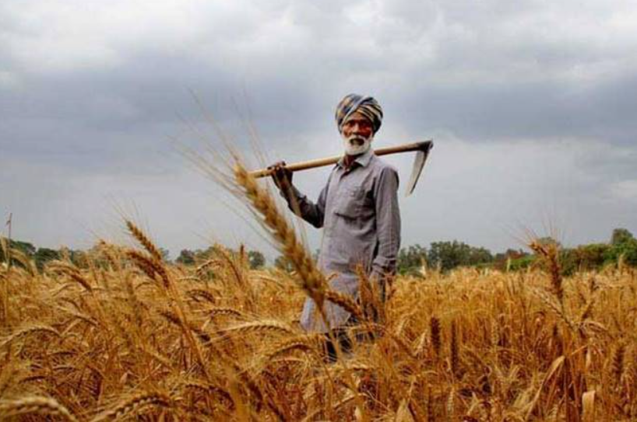
THE THIRD PILLAR – Inclusive Development for Aspirational India

Slide 9
THE THIRD PILLAR - HIGHLIGHTS
AGRICULTURE
Farmers to receive a concessional credit boost.
Ensured MSP at minimum 1.5 times the cost of production across all commodities.
Farmers to be provided with emergency working Capital.
5 Major shipping harbours- Kochi, Chennai, Vishakhapatnam, Paradip and Petuaghat
Development of Animal Husbandry Infrastructure.
Essential commodities Act is set to be amended.
The Coverage of Swamitva Scheme will be extended to all states.
An additional 1,000 mandis will be integrated with e-NAM.
Operational Green Scheme will be expanded to include as many as 22 perishable products.
MIGRANT WORKERS AND LABOURERS
One Nation One Ration Card to be rolled out to Migrant workers
Migrant workers to receive free food grain supply
Social security benefits to be extended to the platform and gig workers
Implementation of 4 labour codes underway..

Slide 10
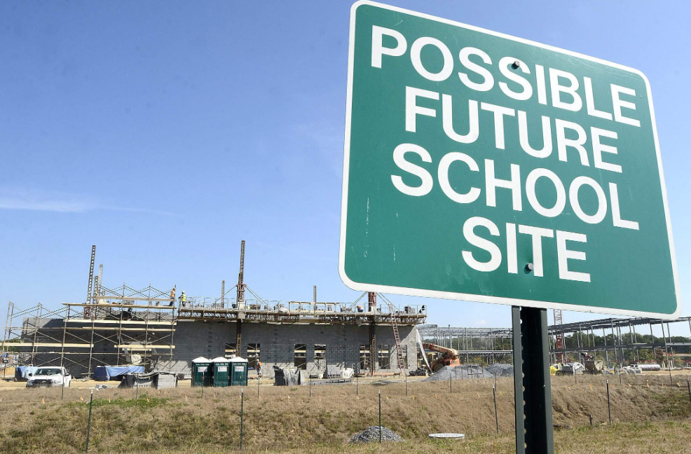
THE Fourth PILLAR – Reinvigorating Human Capital

Slide 11
THE FOURTH PILLAR - HIGHLIGHTS
100 New Sainik Schools to be setup.
750 new Eklavya schools to be setup in Tribal areas.
Revamped Post Matric Scholarship Scheme for welfare of Scheduled castes.
Proposed amendment to Apprenticeship Act to enhance opportunities for youth.
Central University to come up in Leh for accessibility of higher education in Ladakh.

Slide 12
THE FIFTH PILLAR – Innovation and R&D

Slide 13
THE FIFTH PILLAR - HIGHLIGHTS
Rs 50,000 Crs outlay over 5 years.
Rs 1,500 Crs to promote digital modes of payment.
PSLV-CS51 to be launched by NSIL carrying Brazil’s Amazonia satellite and some Indian Satellites.
First unmanned launch is slated for December 2021.
Rs 4,000 Crs over five years for Deep Ocean mission survey exploration and conservation of deep sea biodiversity.

Slide 14
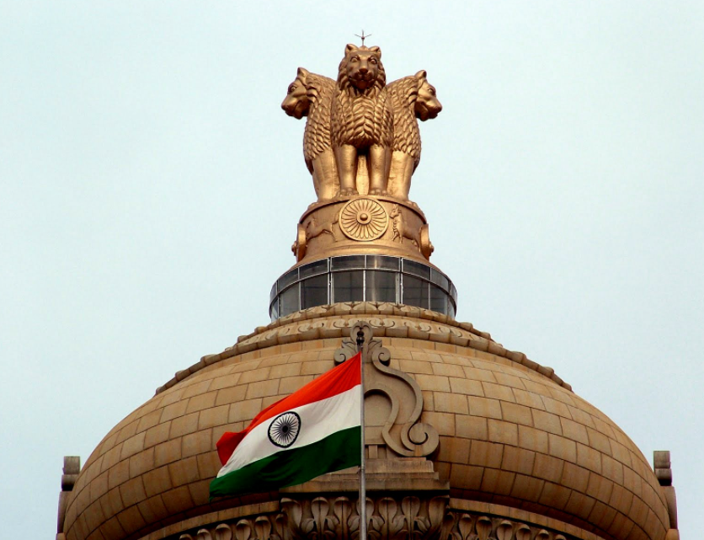
THE SIXTH PILLAR – Minimum Government, Maximum Governance

Slide 15
THE SIXTH PILLAR - HIGHLIGHTS
Rs 3,768 Crs allocated for first digital census in the history of India
Rs 300 Crs grant to the government of Goa for the diamond jubilee celebrations of the state’s liberation from Portuguese.
Rs 1,000 Crs for the welfare of Tea workers especially women and their children in Assam and West Bengal.
Proposed conciliation mechanism with mandate for quick resolution of contractual disputes with CPSE’s

Slide 16
FISCAL POSITION
ITEM | ORIGINAL BE 2020-21 | RE 2020-21 | BE 2021-22
EXPENDITURE | Rs 30.42 lakh Crs | Rs 34.50 lakh Crs | Rs 34.83 lakh Crs
CAPEX | Rs 4.12 lakh Crs | Rs 4.39 lakh Crs | Rs 5.5 lakh Crs
FISCAL DEFICIT (as percent of GDP) | - | 9.5% | 6.8%
Gross borrowing from the market for the next year to be around 12 lakh Crs.
Plan to continue on the path of fiscal consolidation – Targeted fiscal deficit by 2025-2026 is 4.5%
Planning to achieve by Monetisation of assets including public sector enterprises and Land.

Slide 17
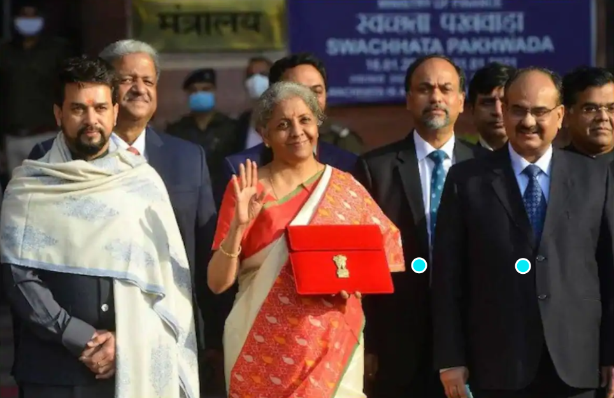
DIRECT TAX PROPOSALS

Slide 18
DIRECT TAXES – KEY CHANGES
FOR UNDERSTANDING, PROPOSALS MADE IN THE AREA OF DIRECT TAXES IN THE BUDGET 2021 ARE GROUPED AS UNDER
CHANGES IN THE HEAD INCOME FROM SALARIES
CHANGES IN THE HEAD PROFITS AND GAINS FROM BUSINESS OR PROFESSION
CHANGES IN THE HEAD INCOME FROM CAPITAL GAINS
RETURN RELATED CHANGES
TDS/TCS RELATED CHANGES
CHANGES IN THE PROVISIONS OF CHARITABLE AND RELIGIOUS TRUST
CHANGES IN DEDUCTIONS
MISCELLANEOUS

Slide 19
DIRECT TAXES – KEY CHANGES
CHANGES UNDER THE HEAD “INCOME FROM SALARY’
Exemption for cash allowance received in lieu of LTC – Sec 10(5)
Cash allowance received in respect of LTC from an employer shall be allowed as exemption provided the same should be used by the assessee or a member of his family during the period from 12.10.2020 to 31.03.2021 on goods or services which attract GST at 12 percent or more. Payment should be made in electronic mode or account payee cheque/DD. Also, the maximum amount of exemption is limited to Rs 36,000/- per person or 1/3rd of expenditure whichever is less.(only for AY 21-22)
[Reason for proposed amendment - Due to Covid 19 Pandemic – employees have not been able to avail the LTC benefit and tax concession in the current block of 2018-2021]
Taxability of Interest on Provident Fund-Sec 10(11) and 10(12)
Interest accrued during the previous year on PF contributions made by employees in excess of Rs 2,50,000/- in a previous year commencing from 1 April 2021 is proposed to be made taxable.

Slide 20
DIRECT TAXES – KEY CHANGES
CHANGES UNDER THE HEAD “PROFIT AND GAINS FROM BUSINESS OR PROFESSION”
NO MAT on Dividend Income of a Foreign Company –Sec 115JB
Dividend received by a Foreign Company on its investments in India shall be excluded for calculation of book profit in case the tax payable on such dividend income is less than MAT liability on account of concessional tax rate provided under DTAA.
Similarly, where income of the past year is included in the total income on account of APA u/s 92CC or on account of secondary adjustment u/s 92CE,the AO shall recompute the book profit of the earlier year, on an application made by the assessee u/s 154 and the time limit shall be reckoned from the date of application.
No Deduction for employees’ contribution towards welfare fund if not deposited before due date
The deduction u/s 36(1)(va) in respect of employees’ contribution to PF/ESI shall be allowed only if such sum is credited to employees’ account in the relevant fund on or before the due date prescribed under the relevant Act.
Cases overruled – Vinay cements Ltd 213 CTR 268, Alom Extrusions Ltd 319 ITR 306

Slide 21
DIRECT TAXES – KEY CHANGES
CHANGES UNDER THE HEAD “PROFIT AND GAINS FROM BUSINESS OR PROFESSION”
Presumptive taxation scheme u/s 44ADA not eligible for LLPs
Only an individual, HUF, or a Partnership firm, not being an LLP, shall be eligible to opt for presumptive taxation scheme u/s 44ADA from AY 2021-22.
To promote digital transcations – threshold limit for tax audit increased
If at least 95 percent of the business receipts are made through electronic modes, the threshold limit for the tax audit is proposed to be increased from Rs 5 Crs to Rs 10 Crs wef effect AY21-22.

Slide 22
DIRECT TAXES – KEY CHANGES
CHANGES UNDER THE HEAD “PROFIT AND GAINS FROM BUSINESS OR PROFESSION”
No Depreciation shall be allowed on goodwill – Amendments to Secs 2(11),32(1)(ii),50 and 55
Sec 2(11) is amended to specifically provide that “block of assets shall not include goodwill.”
Sec 32(1)(ii) is amended to provide that goodwill shall not be considered as an asset for the purpose of depreciation.
Sec 50 is amended to provide that where GW formed part of block of asset for AY beginning 1st Apr 2020 and depreciation has been obtained by the assessee, WDV and STCG shall be determined in the manner as may be prescribed.
Sec 55 is amended to provide that if assessee has claimed depreciation on goodwill prior to AY 21-22, then the cost of purchase of such goodwill in his hands shall be reduced by such amount of depreciation while computing Capital gains.
[refer Hon. SC decision in the case of Smiffs Securities Ltd 348 ITR 302(SC), where the apex court held that goodwill of a business/profession is a depreciable asset u/s 32 of the IT Act.]
.

Slide 23
DIRECT TAXES – KEY CHANGES
CHANGES UNDER THE HEAD “PROFIT AND GAINS FROM BUSINESS OR PROFESSION”
No Equalisation Levy on Royalty or FTS – Sec 10(50)
Sec 10(50) of the IT Act provides exemption of income from any specified services as provided in FA 2016 or through e-commerce supply/services or through such facilities arranged on or after the 1st day of Apr 2021, provided Equalisation levy was chargeable. The bill proposes not to charge Equalisation levy on consideration received/receivable for specified services or e- commerce supply/service which is taxable as Royalty or FTS. Amendment shall take effect from AY 21-22.
Scope of e-commerce supply/service, online sale of goods and online provisional services enlarged.

Slide 24
DIRECT TAXES – KEY CHANGES
CHANGES UNDER THE HEAD “INCOME FROM CAPITAL GAINS”
Transfer of Capital Asset to Partner/member on dissolution of the firm/AOP/BOI taxable as capital gains – Secs 45(4) and 45(4A)
Sec 45(4) - It has been proposed that, if a partner/member receives any capital asset at the time of dissolution/reconstitution of the firm/AOP/BOI, from such entity, then any profits or gains arising from receipt of Capital asset by the partner/member (without considering revaluation or value of goodwill) shall be chargeable as income of the firm/BOI/AOP under the head capital gains in the year of receipt of capital asset by the partner/member. For the purpose of sec 48, FMV of the capital asset shall be the full value of consideration.
Decision overruled - Electroplast Engineers 310 CTR 238 (BOM) – Payment to retiring partner – not transfer.
Sec 45(4A) -It has been proposed that, if a partner/member receives any money/asset at the time of dissolution/reconstitution of the firm/AOP/BOI, which is more than the balance appearing in the capital account (without considering revaluation or value of goodwill), the profits or gains arising from such receipts shall be chargeable under the head ‘capital gains’ as income of such firm/AOP/BOI of the previous year in which such money or asset is received by the specified person. The amendment shall come into effect from AY 21-22.

Slide 25
DIRECT TAXES – KEY CHANGES
CHANGES UNDER THE HEAD “INCOME FROM CAPITAL GAINS”
Taxation of Unit Linked Insurance Policy (ULIP) – Sec10 (10D)
The exemption u/s 10(10D) shall not be available with respect to any ULIP issued on or after 01.02.2021, if the amount of premium payable for any of the PY during the term of the policy exceeds Rs 2,50,000/- per annum. Further, the ULIP which is not eligible for exemption shall be treated as a Capital Asset.
[Reason – To avoid high net worth Individuals from claiming benefit]
Extension in time limit for transfer of residential house property for Sec 54GB exemption
It has been proposed to extend the deadline for claiming exemption by investing the proceeds from transfer of long term residential house property in the equity shares of a eligible start up from 31.03.2021 to 31.03.2022.
Scope of Slump Sale expanded – Sec 50B
The scope of the term slump sale is proposed to be expanded to include all types of transfers as specified under section 2(47). The amendment shall come to effect from AY 21-22.
Decision Overruled Bharat Bijlee 365 ITR 258 (BOM) – (Exchange)

Slide 26
DIRECT TAXES – KEY CHANGES
CHANGES UNDER THE HEAD “INCOME FROM CAPITAL GAINS”
Revision in safe harbour limit in respect of transfer of immovable property below SDV –Sec 43CA
It has been proposed to increase the safe harbour limit from earlier limit of 10 percent to 20 percent in case of transfer of residential property during the period from 12.11.2020 to 30.06.2021 by way of first time allotment to any person. Further, the consideration received or accruing as a result of such transfer shall not exceed 2 Crs. The Amendment comes wef AY 21-22.
[Reason – to boost the demand in real estate and to enable the real-estate developers to liquidate their unsold inventory]

Slide 27
DIRECT TAXES – KEY CHANGES
INCOME TAX RETURN RELATED CHANGES
Reduction in time limit for filing of belated or revised return Secs 139(4) and 139(5)
Time limit for filing belated or revised returns reduced by 3 months. Now, these are to be filed on or before 31st December of the AY or completion of assessment whichever is earlier. AY 21-22.
Exemption from filing ITR by an Individual whose age is 75 or above – Sec 139(1)
Resident senior citizen – age 75 or above – having pension income and interest income from the same bank in which he is receiving his pension – is exempted from filing ITR. However, the bank will deduct tax at rates in force. AY 21-22.
Time limit for ITR filing of Partners of a firm liable for audit as per Sec 92E
Due date changed from 31st October to 30th November wef AY 21-22.
Reduction in time limit for processing of ITR and issuance of notice Secs 143(1) 143(2)
Time limit for processing of ITR is proposed to be reduced from 1 year to 9 months from the end of the FY in which return is filed. Also, time limit for serving scrutiny notice is proposed to be reduced from 6 months to 3 months from the end of the FY in which return is filed. (applicable for returns filed for AY 21- 22 onwards)

Slide 28
DIRECT TAXES – KEY CHANGES
INCOME TAX RETURN RELATED CHANGES
Adjustments to be made by CPC while processing ITR u/s 143(1)
Existing provision allows CPC to disallow certain expenses indicated in TAR but not considered in computation. The CPC can now make adjustments to increase the income also. Wef 1st Apr 2021.
Notice to file return of Income can be issued by Prescribed Authority – Sec 142(1)
To enable centralised issuance of notices in an automated manner, 142(1) notices can now be issued by prescribed authority. Earlier, 142(1) notices can only be issued by AO.

Slide 29
REVISED Due dates in a NUTSHELL
Milestone | Existing due date | Revised due date
Filing of original return of Income (as the case may be) | 31.07.2021 31.10.2021 30.11.2021 | No change
Filing of belated or revised return of Income | 31.03.2022 | 31.12.2021
Issue of notice u/s 143(1) – processing of return | 31.03.2023 | 31.12.2022
Issue of notice u/s 143(2) – scrutiny assessment | 30.09.2022 | 30.06.2022
Completion of scrutiny assessment – 143(3) | 31.03.2023 | 31.12.2022
Completion of best judgement assessment -144 | 31.03.2023 | 31.12.2022

Slide 30
DIRECT TAXES – KEY CHANGES
INCOME ESCAPING ASSESSMENT - Sec 148
Department now has scores of information due to advancement of technology.
Information is received from other law enforcement agencies also. Such information is shared with the tax payer through AIR u/s 285BB.
Department matches information collected with ITR.
Therefore, assessment/reassessment to a large extend is information driven.
New procedure for assessments/reassessments announced. Salient features are:
Search assessments u/s 153A to 153D abolished wef 01.04.2021.
Sec 147 proposes to allow the AO to assess/reassess/recompute any income escaping assessment for any AY. (called relevant AY)
Notice u/s 148 to be issued when there is information with the AO which suggests escaped income.
Prior approval of specified authority required before issuing notice.

Slide 31
DIRECT TAXES – KEY CHANGES
INCOME ESCAPING ASSESSMENT - Sec 148
Information flagged in the case of an assessee for relevant AY (largely through computer based system) in accordance with risk management strategy formulated by the Board shall be information for reopening.
A final audit objection raised by C&AG shall be considered as information for escaped assessment.
In cases of search/survey/requisition initiated after 1st April 2021, it shall be deemed that AO has information to the effect that income chargeable to tax has escaped assessment for 3 AYs immediately preceding the PY of search/survey/requisition.
Before issuance of notice, AO to conduct enquiries if required and provide an opportunity of being heard – New Sec 148A.
Thereafter, AO will decide by an order whether it is a fit case for issuing notice u/s 148 and shall serve a copy of the order along with such notice.
AO to obtain approval from specified authority.
Above procedure not applicable for search/requisition cases.

Slide 32
DIRECT TAXES – KEY CHANGES
TIME LIMIT FOR ISSUE OF NOTICE ON INCOME ESCAPING ASSESSMENT - Sec 149
In normal cases, no notices shall be issued beyond 3 years from the end of the relevant AY.
Where AO possesses evidence which reveal income escaping assessment represented in the form of assets amounts to/likely to amount to Rs 50 lakh or more, notice can be issued beyond 3 years but not beyond 10 years from the end of the relevant AY.
No notice u/s 148 can be issued at any time in a case for the relevant AY beginning on or before 1st Apr 2021 if such notice could not have been issued at that time on account of the time limit prescribed under the present act.
Old time limit will continue for searches initiated up to 31st March 2021.
Specified authorities for approval of various tasks are as follows;
PCIT/PDIT/CIT/DIT – if 3 years or < 3 years has elapsed from the end of relevant AY.
PCCIT/PDGIT/CCIT/DGIT – if more than 3 years have elapsed.
AO empowered to assess/reassess income covering issues that has come to his notice after the procedure prescribed in 148A.

Slide 33
DIRECT TAXES – KEY CHANGES
TDS/TCS RELATED CHANGES
TDS on purchase of goods – New Sec 194Q
It is proposed to insert a new Sec for deduction of TDS by a person (whose turnover exceeds Rs 10 Crs in the immediately preceding PY) who is paying any sum to any resident for purchase of any goods of the value exceeding Rs 50 lakhs in any previous year. The tax shall be deducted at the rate of 0.1%, which shall be increased to 5% if the seller does not provide his PAN.
Exeptions – 1. CG empowered to exempt any person from this obligation by way of notification on fulfilment of condition specified there in.
2. not applicable if transactions liable for TDS under any other provisions.
3. A transaction on which TCS is applicable u/s 206C other than u/s 206C(1H)
4. if on a transaction 206C(1H) as well as TDS under this section is applicable, then only TDS under the Sec be carried out.
Amendment wef 1st July 2021.

Slide 34
DIRECT TAXES – KEY CHANGES
TDS/TCS RELATED CHANGES
No TDS on dividend distributed by the SPV to the business trust
Business Trusts have been provided with the status of a pass-through entity, whereby, they are allowed to pass certain income to their unit holders without paying tax at their end. It is proposed to provide that no tax shall be deducted on payment of dividend by the SPV to the business trust.
Non-filer shall be subject to TDS/TCS at higher rates – New Sec 206AB and Sec 206CCA
Two new sections are inserted to penalise the non filers of Income Tax return. The rate of TDS/TCS shall be double the specified rate or 5% whichever is higher. These new sections will not be applicable if tax is to be deducted u/c 192, 192A, 194B, 194BB, 194LBC or 194N of the Act. However, this section is applicable only if ITR not filed for two AYs relevant to the last 2 PYs immediately prior to the period in which tax is required to be collected.

Slide 35
DIRECT TAXES – KEY CHANGES
CHANGES IN THE PROVISIONS OF CHARITABLE AND RELIGIOUS TRUSTS
Set-off of deficit not allowed to Charitable Institutions
It has been proposed that the charitable institutions shall not be permitted to claim any carry forward of losses. Therefore no set-off/deduction/allowance of any excess application of any preceding year shall be allowed while computing income required to be applied during the previous year by such institutions.
Amount applied out of loans not to be considered as an application of Income
It has been proposed that utilisation of borrowed money shall not be considered as an application of income. However, when loan/borrowings are repaid from the income of the previous year, such repayment shall be allowed as an application in the previous year in which it is repaid.
Decision confirmed – Medical Relief Society of South Canara 2019 Taxpub (DT6987)

Slide 36
DIRECT TAXES – KEY CHANGES
CHANGES IN THE PROVISIONS OF CHARITABLE AND RELIGIOUS TRUSTS
Corpus Contributions to be exempt only if invested
Voluntary contributions made with a specific direction that it shall form part of the corpus shall be eligible for exemption u/s 11(1)(d) only if it is invested/deposited in modes specified u/s 11(5). Further, the amount spent from such corpus shall not be considered as an application against the mandatory 85% application of non-corpus income.
Exemption to educational and medical institutions have annual receipt up to Rs 5 Crs
The limit of exemption which is currently at 1 Crs annual receipts u/s 10(23C)(iiiad) and 10(23C)(iiiae) is proposed to be increased to 5 Crs. Amendments wef 1st April 2022.

Slide 37
DIRECT TAXES – KEY CHANGES
CHANGES PROPOSED IN DEDUCTIONS
Sec 80IBA deduction to rental housing projects – date extended
The deduction of 100% of the profits and gains derived by an assessee from the business of developing and building affordable housing projects that are approved on or before 31.03.2021 is extended to 31.03.2022. Further, to promote migrant labourers and to promote affordable rental housing, the scope of 80IBA is proposed to be expanded to allow deduction in respect of rental housing projects as well.
Extension in the due date for incorporation of start up companies for Sec 80IAC
The earlier condition u/s 80IAC is that the start up company should be incorporated between 01.04.2016 to 31.03.2021 which is now proposed to be extended to 31.03.2022.
Extension in the time limit for sanction of housing loan for deduction under Sec 80EEA
Additional deduction of Rs 1.5 lakhs u/s 80EEA for interest on housing loan is allowed if such loan is sanctioned on or before 31.03.2021. The outer date is now extended to 31.03.2022.

Slide 38
DIRECT TAXES – KEY CHANGES
MISCELLANEOUS PROPOSALS
Relief from interest for any defecit in the advance tax liability due to dividend Income
If the shortfall in the advance tax instalment is due to dividend Income, It is proposed that, no interest u/s 234C shall be charged if the assessee has paid full tax in subsequent advance tax instalment(s).
Provisional Attchment of assets in the case of Fake invoices
If the aggregate amount of penalty imposable exceeds Rs 2 Crs, then AO is empowered to provisionally attach the property of the assessee during the pendency of proceedings u/s 271AAD.
No Interest on refund of the excess sum paid under IDS
Excess amount of tax, surcharge or penalty paid in pursuance of a declaration made under the scheme shall be refundable without payment of any interest thereon.

Slide 39
DIRECT TAXES – KEY CHANGES
MISCELLANEOUS PROPOSALS
Clarification regarding the scope of Vivaad se Viswas Scheme 2020
It has been proposed to clarify that the appellant under the scheme does not include a person in whose case a Writ/SLP or any other proceeding has been filed before an appellate forum, arising out of an order of a settlement commission and such petition or appeal is either pending or disposed of. Similarly, the term disputed tax does not include sum payable under order passed by settlement commission.
New Dispute Resolution Committee – End of Settlement Commission
It is proposed to set up a dispute resolution committee for tax payers with taxable income up to 50 lakhs and disputed income up to 10 lakhs. Consequently, no application shall be given for settlement commission w.e.f 01.02.2021.
National Faceless Income Tax Appellate Tribunal
Following up with the National e-assessment, National e-appeal and National e-penalty, it is now proposed to start faceless ITAT, wherein all communication between the Tribunal and appellant shall be electronic.

Slide 40
DIRECT TAXES – KEY CHANGES
MISCELLANEOUS PROPOSALS
Pre-Filling of returns – Enabling ease of filing returns
It is proposed that the details of capital gains from listed securities, dividend income and interest from banks, post offices etc will also be pre-filled in returns in addition to details of salary, tax payment and TDS which already come pre-filled in returns.

Slide 41
INDIRECT TAX PROPOSALS

Slide 42
INDIRECT TAXES – KEY CHANGES
HIGHLIGHTS OF PROPOSED CHANGES UNDER GST
Introduction of a new condition for availing ITC
Sec 16(2) is amended to include a new condition for availing ITC. It has been provided that ITC on invoice or debit note can be availed only when the details of such invoices/debit notes are furnished by the supplier in its Form GSTR1 and the same is reflected in the GSTR2A of the recipient.
Amendments related to Zero rated Supply
The general option for making Zero rated supply with payment of IGST and claiming refund is done away with. Only notified class of persons and notified goods and services can be exported by payment of IGST. The amendment proposes to allow export of goods and services only under a Bond/LUT.
No separate filing of form GSTR 9C; Self-certified reconciliation statement
The requirement to get the annual accounts audited by a chartered accountant and submit GSTR- 9C is done away with. Now, along with annual accounts, a self certified reconciliation statement to be submitted. Also, it is proposed that any dept of the CG or SG or local authority whose accounts are required to be audited by CAG would not be required to comply with the above requirement also.

Slide 43
INDIRECT TAXES – KEY CHANGES
HIGHLIGHTS OF PROPOSED CHANGES UNDER GST
Interest on Net cash liability
Amendment in Sec 50 of the CGST Act through Finance Act, 2019 was made by which a proviso was introduced under Sec 50 to provide that interest shall be charged on the portion of the tax that is paid by debiting the cash ledger. However, the proviso was introduced with prospective effect which attracted a lot of litigations. To put the litigations under rest, it is now proposed that the proviso shall be applicable with retrospective effect from July 01, 2017.
Recovery of tax in respect of transactions declared in Form GSTR1
It is proposed to amend the meaning of self assessed tax. The self assessed tax has been defined to include the tax payable in respect of outward supplies furnished in form GSTR1, but not included in Form GSTR3B. Therefore, now if a person has declared the details of outward supplies in form GSTR1 but has not discharged the tax liability via GSTR3B, then recovery proceedings may be initiated to collect the difference.

Slide 44
INDIRECT TAXES – KEY CHANGES
HIGHLIGHTS OF PROPOSED CHANGES UNDER GST
Increasing the penalty on seized goods
Under Sec 129, if any persons stores or transports goods in contravention of CGST Act, then such goods are liable to be confiscated. These goods will be released subject to payment of penalty as under
Scenario | Nature of goods | Existing provisions | Proposed amendment
If the owner comes forward | Taxable goods | Applicable tax and 100% penalty | Penalty equal to 200% of tax payable on such goods
 | Exempted goods | Penalty 2% of the value of goods or 25,000 whichever is lower | No change
If the owner doesn't come forward | Taxable goods | Applicable tax and 50% penalty on the value of goods. | Penalty equal to 50% of the value of such goods or 200% of tax payable on such goods whichever is higher.
 | Exempted goods | Penalty 2% of the value of goods or 25,000 whichever is lower | No change

Slide 45
INDIRECT TAXES – KEY CHANGES
HIGHLIGHTS OF PROPOSED CHANGES UNDER GST
Penalty to be deposited before filing appeal to Appellate Authority for the detention of goods/conveyance
It is proposed that Appeal shall be filed against order u/s 129(3) only if at least 25% of penalty as mentioned in the order is deposited.

Slide 46



